Slide 1
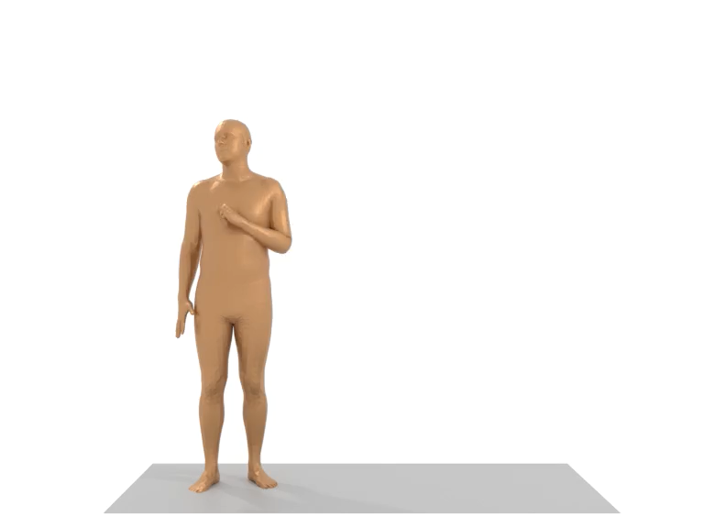
SYNTHETIC HUMAN MOTION GENERATION For AR
Name: Tejas Ramakrishnan Mentor: Myungjae Jeon Team: Samsung Research Augmented Reality Lab
12th July 2023

Slide 2
NEED FOR human motion data?
AR user experience is heavily dependent on accurate human motion prediction
Delays cause misalignment between the virtual content and the physical world. Leads to a sense of time latency and dizziness for users.
Hence a need for accurate human motion prediction for a good virtual experience.
To develop accurate algorithms for 6DOF motion prediction, human motion datasets are needed.
Such data helps determine future position and viewpoint within an environment, allowing for proactive adjustment of virtual content based on anticipated perspective

Slide 3
WHY SYNTHETIC GENERATION?
Capturing human motion data physically can be expensive and time-consuming.
Synthetic data generation as an alternative is a feasible and cost-effective alternative.
Synthetic data generation techniques enable the creation of large-scale and realistic human motion datasets.
This project addresses the need of synthetic human motion data for reducing AR latency.

Slide 4

Project goals
To generate framework for synthetic human motion generation for reducing latency in AR applications through advanced motion prediction algorithms.
Targets:
Pure Human Motion
With scene w/o interaction
Including interaction with surrounding

Slide 5

LITERATURE REVIEW

Slide 6
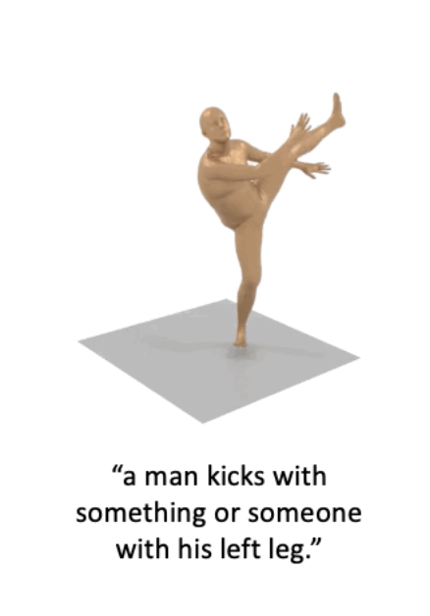
Without scene generation:
Human motion is modelled as a sequence of joints positions in space
Generative/VAE models are low-quality or limited in expressiveness.
Diffusion models are promising for human motion synthesis
Motion Diffusion Model (MDM) is chosen for our use case
It is SOTA in generating diverse, realistic human motion
However, MDM generates short time period motion
DoubleTake module enables the efficient generation of long motion sequences in a zero-shot manner using MDM as a prior.
Notes:
Diffusion models: promising \due to their many-to-many nature.

Slide 7
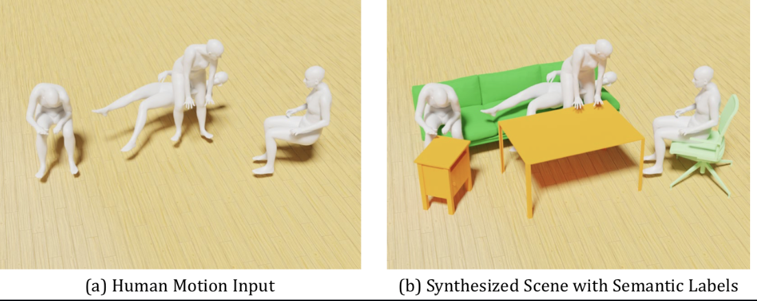
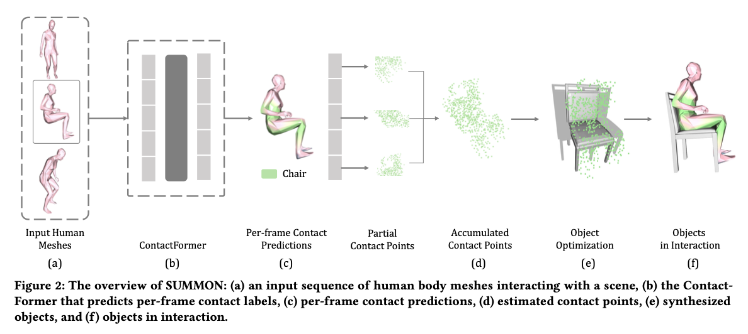
WITH SCENE GENERATION
Two high level classes of models for scene generation with human motion
First type of models(CVAE based) fit the generated human to a fixed scene
Pure Human motion contains rich information about the scene they are in.
SUMMON model was chosen as it fits scene to motion using that information, and maintains integrity of human motion
Notes:
Posterior collapse of CVAE models: first class generally CVAE based

Slide 8

PROGRESS AND Deliverables

Slide 9
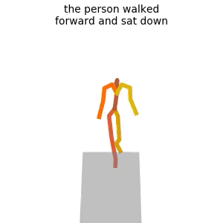
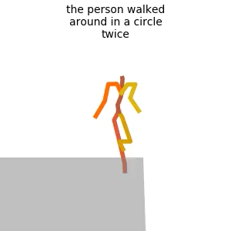
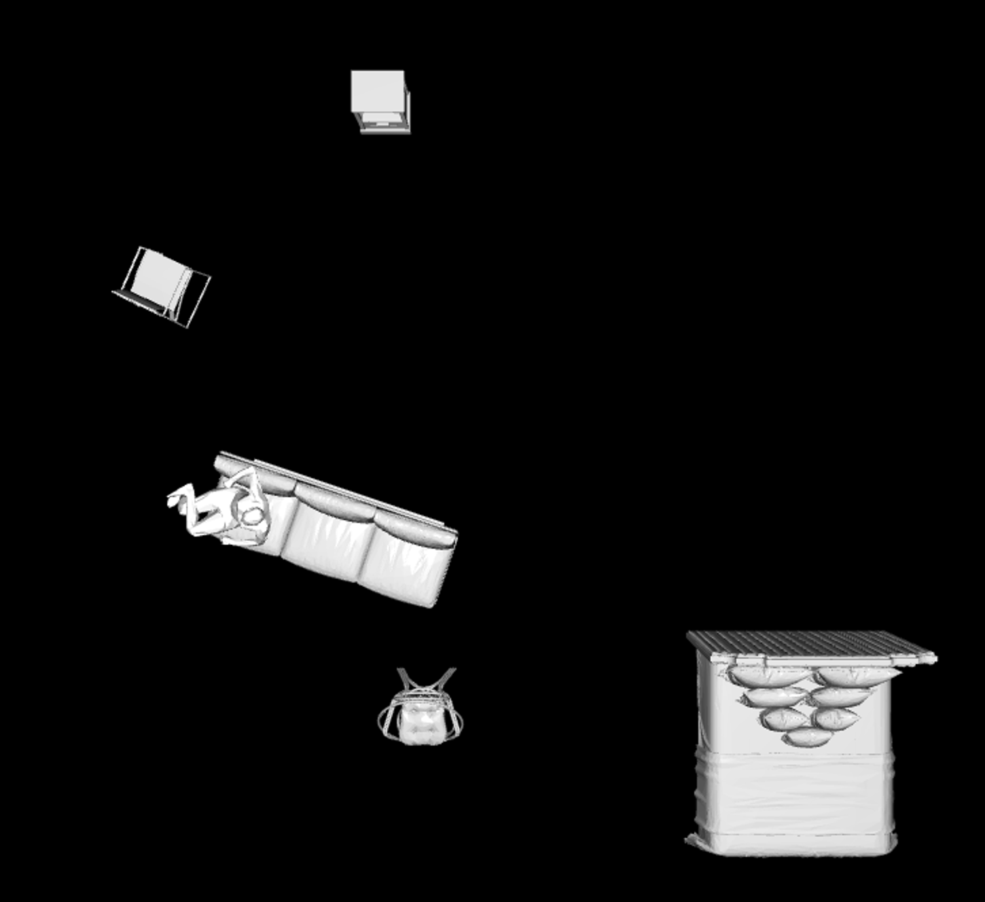
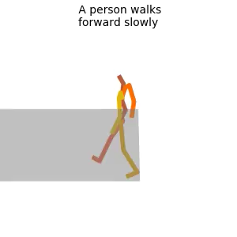
1.MDM+ Doubletake 2.SUMMON IMPLEMENTATION
Example outputs
Implemented framework that generates human joint positions over time using MDM
Extended with DoubleTake implementation of PriorMDM for long term motion generation, with output in the same format
Implemented framework for scene synthesis with human motion in PyTorch with SUMMON
Summon takes human input in SMPL-X downsampled form
SUMMON
Long motion

Slide 10
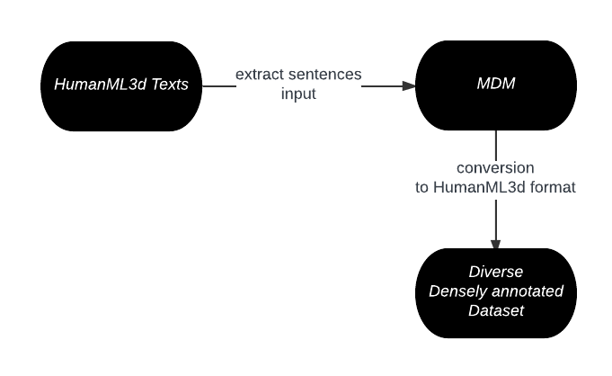
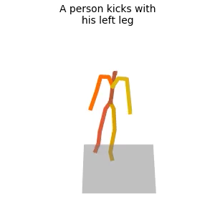
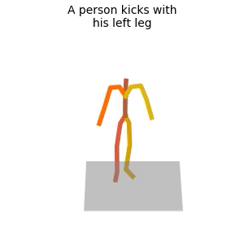
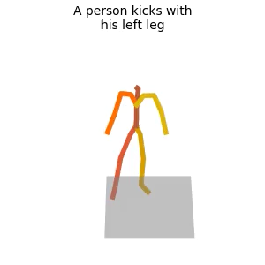
Target 1: DIVERSE DENSELY Annotated HUMAN DATASET generation
a man kicks something or someone with his left leg.#a/DET man/NOUN kick/VERBa something/PRON or/CCONJ someone/PRON with/ADP his/DET left/ADJ leg/NOUN#0.0#0.0
HumanML3D is difficult to reconstruct and lacks diversity
MDM models great diversity in human motion
Shell script to generate data
Subtly different motions of same input text
Notes:
Pass output of contactFormer through softmax function using –save_probability argument.
contactFormer now produces a 8 dimensional vector for each vertex of each frame, indicating the probability of each of the 8 object categories.

Slide 11
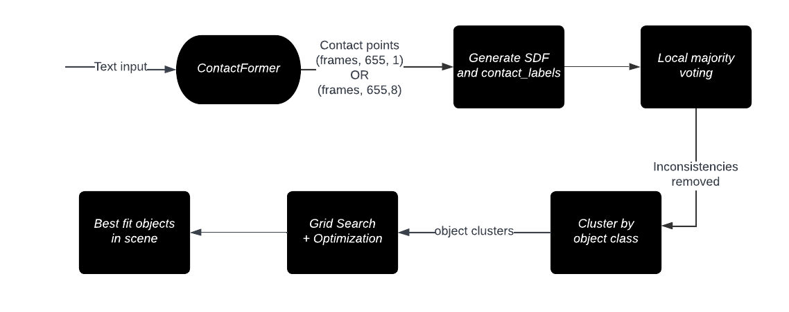
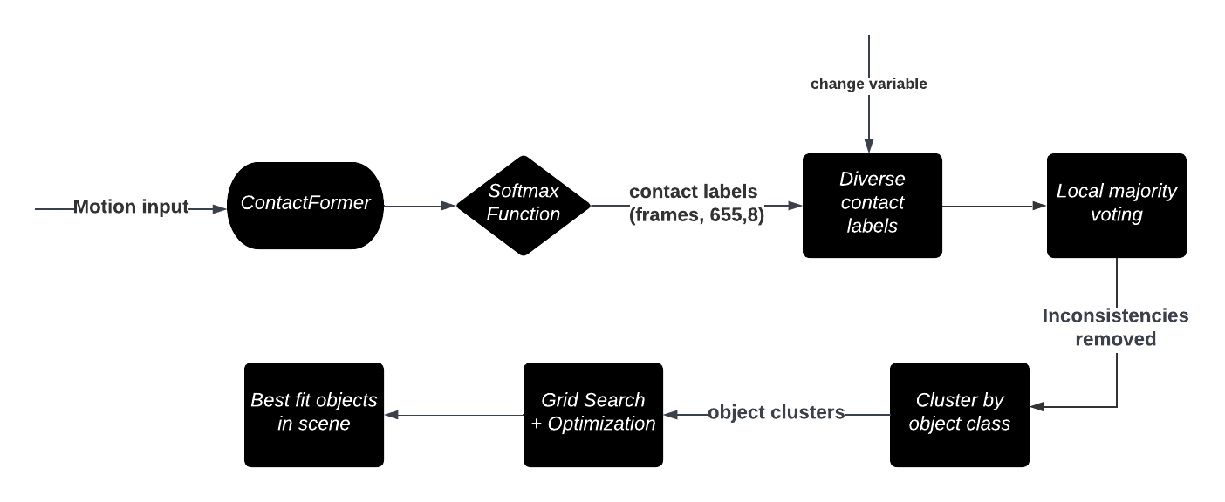
TARGET 2: one-to-many scene generation 1.object replacement 2.Object manipulation
Existing pipeline for object fitting
Modified pipeline for object fitting
Replace objects with semantically similar instances
Notes:
Eg to replace a chair with a sofa in an orientation that maintains realism of human motion
A

Slide 12
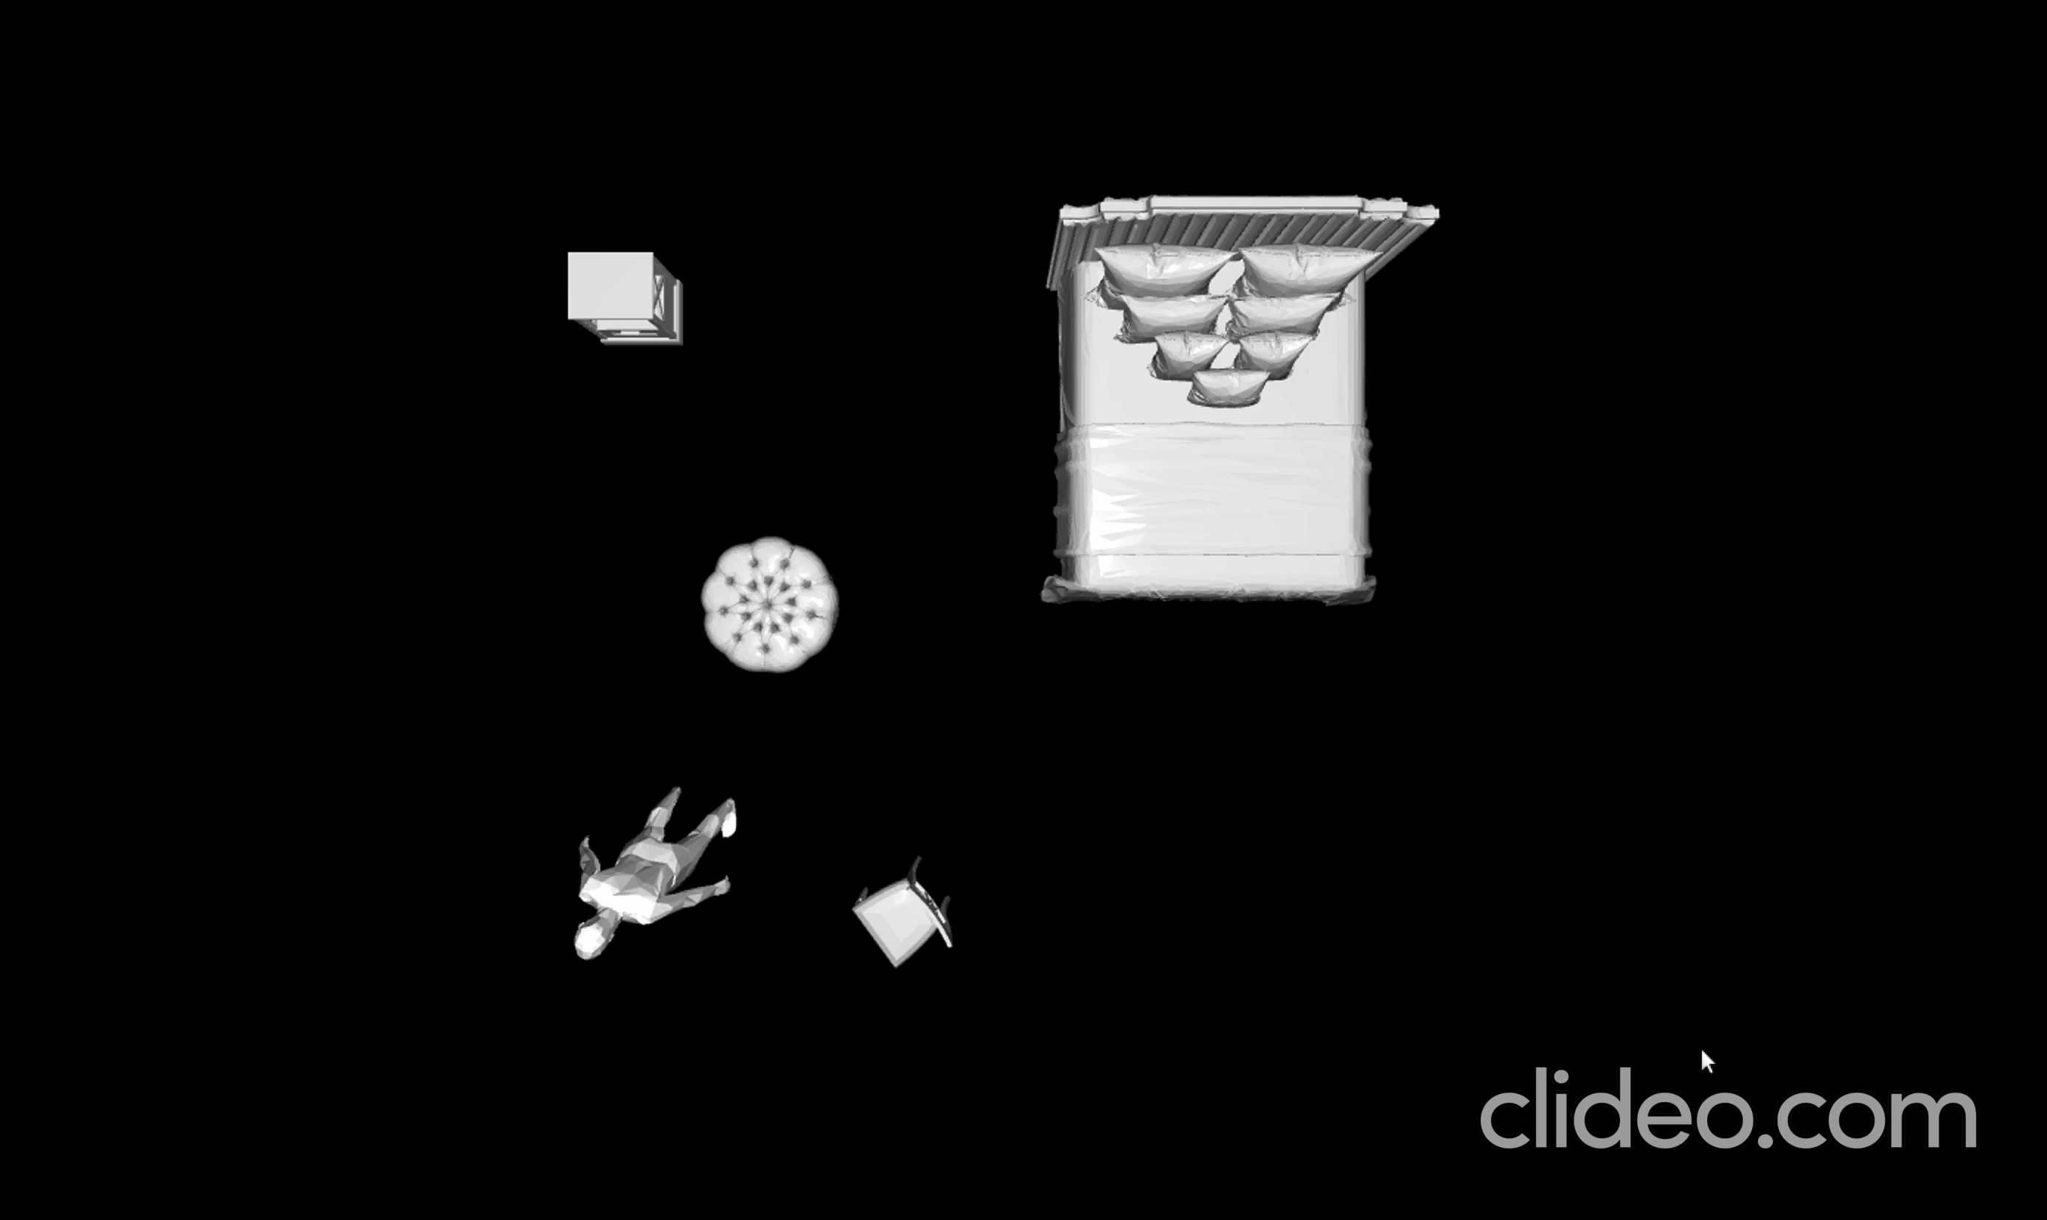
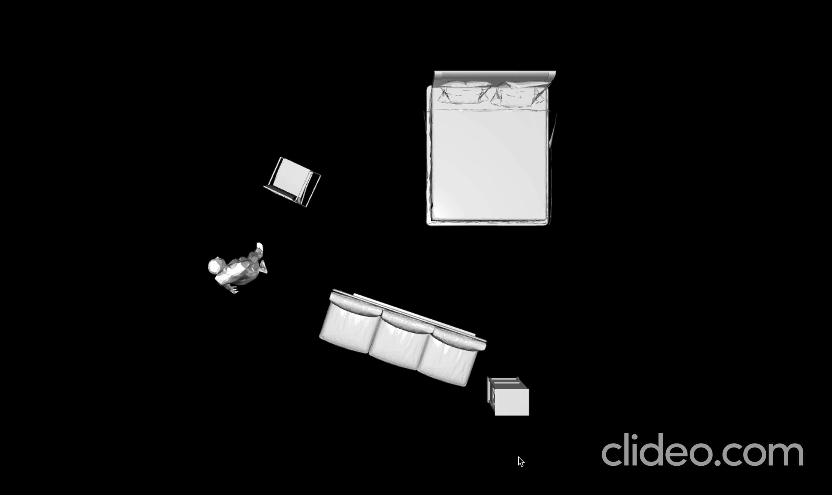
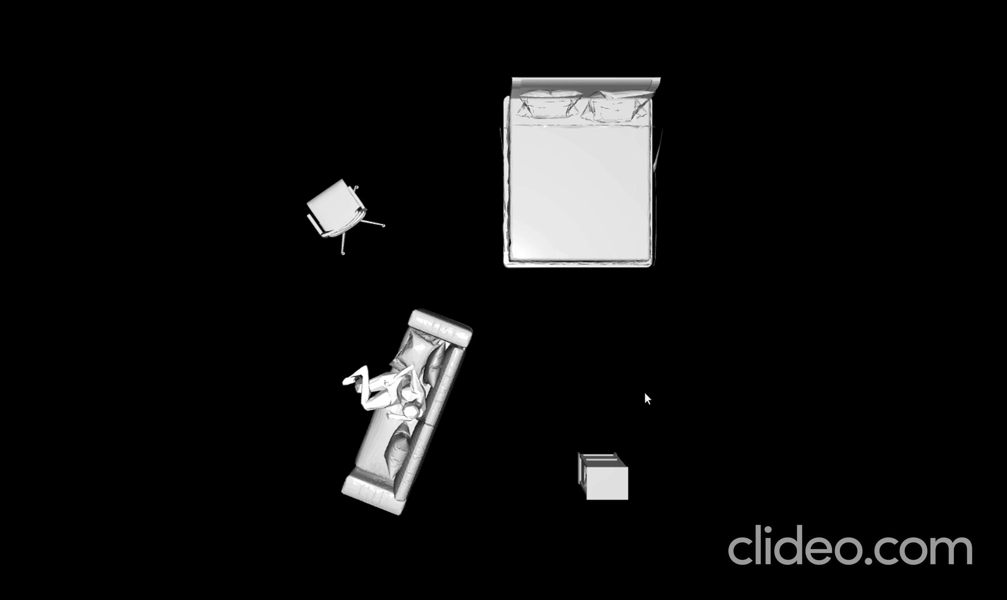
Target 2 one-to-many scene generation: output videos
Type 1
Type 2

Slide 13
Targets 3 & 4: SYNTHETIC PIPELINE FOR MOTION SYNTHESIS
Existing scene algorithms use input moCap data
Such data is limited in availability and expensive
No completely synthetic pipeline exists which limits data diversity and availability
A synthetic pipeline would allow generation of completely new motions and scenes at discretion
Target is to leverage MDM output for scene generation
Target 3: Generation of scene w/o interaction from MDM output of pure human motion
Target 4: Generation of scene with interaction using MDM output of pure human motion
Notes:
Limited data and less diverse: so scenes with interaction are limited and cant be producesd as we desire. Leverage MDM output for scene generation which would generate synthetic pipeline : exmplain why this will be useful
Target 4: example (for example, addition of a chair when human sits down)

Slide 14
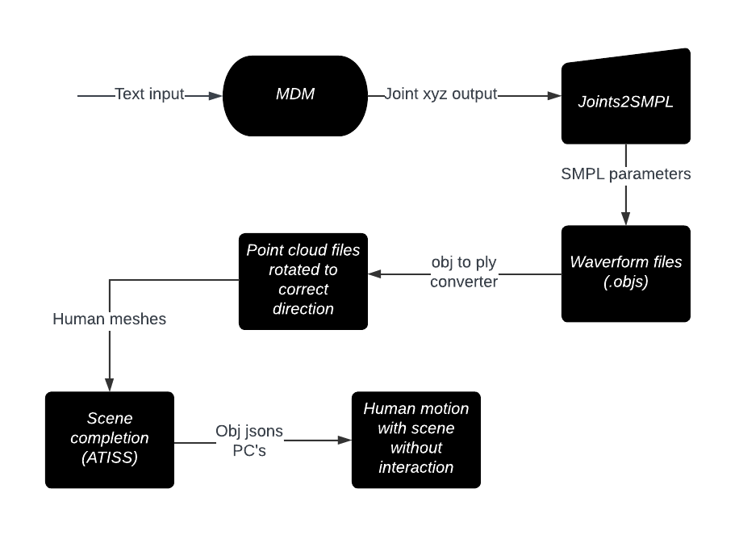
TARGET 3: pipeline
Feed text prompt to MDM to get joint output
Convert output to SMPL form and store OBJS
Convert to point cloud format using python script
Normalize orientation to xy plane by applying a mesh rotation of ( 3𝝿/2, 𝝿, 𝝿)
Apply grid based auto regressive scene completion algorithm(ATISS) for diverse scene completion
Notes:
The floor is divided into a grid, and each cell is labeled as occupied if feet vertices or object vertices are in close proximity
Uses autoregressive transformer model trained on the 3D-FRONT object dataset
The model takes as input the categories of existing objects and returns a probability distribution of the next object category.

Slide 15
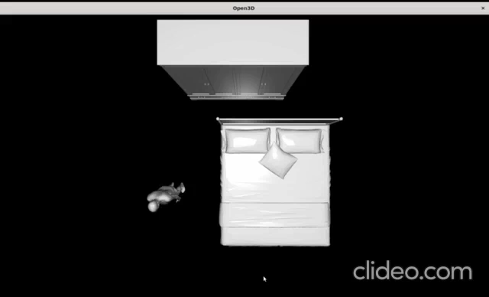
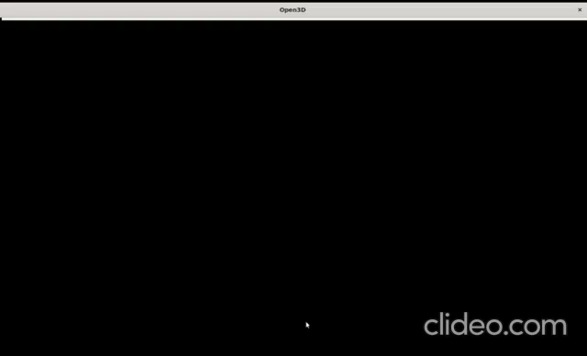
target 3: EXAMPLE VIDEOS
Input motion has been generated by MDM

Slide 16
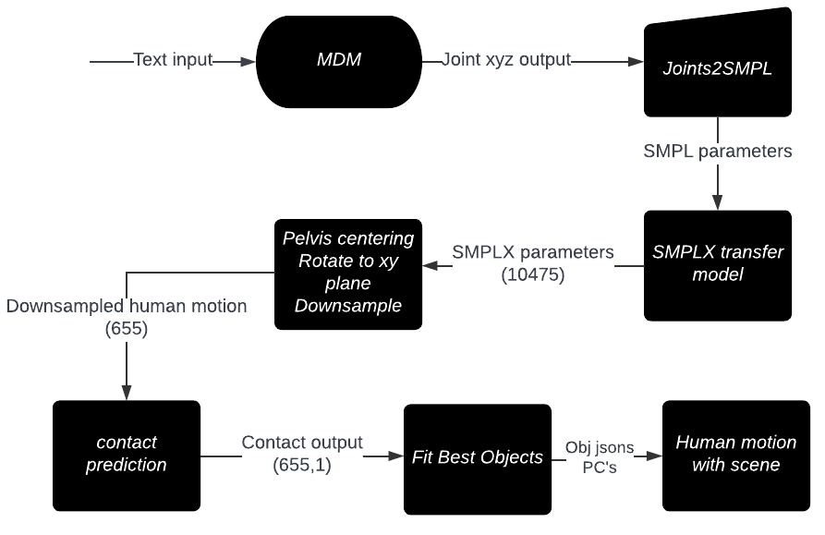
TARGET 4: PIPELINE
Transfer model of SMPLX is used for conversion of SMPL mesh output of MDM to SMPLX parameters with 10475 vertices
To be followed by pre-processing (down-sampling, normalizing)
Initially a complicated 6-7 command process across 3 environments and code blocks with different conventions
Wrote script for 2-command, 2 environment conversion to SUMMON input form which also saves space.
Notes:
Pass output of contactFormer through softmax function using –save_probability argument.
contactFormer now produces a 8 dimensional vector for each vertex of each frame, indicating the probability of each of the 8 object categories.

Slide 17
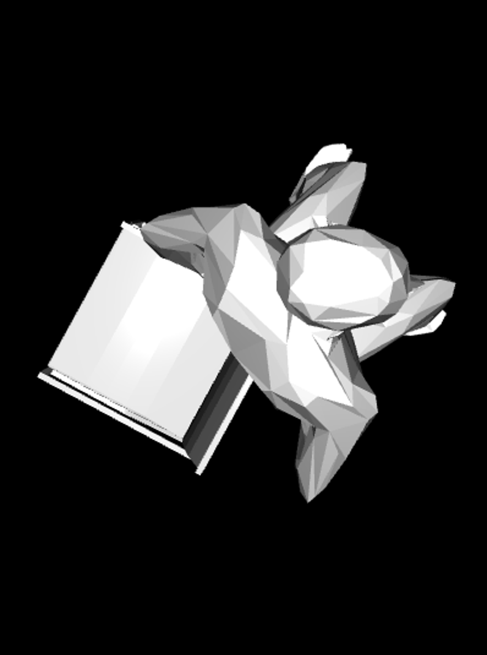
Target 4: OUTPUT
Interaction is produced but objects are placed at semantically sub-optimal positions as shown in figure
Performance increase was not observed on fixing input format, increasing motion length, or hyperparameter tuning
May be due to small dataset that SUMMON is trained on
With improvement in performance, any arbitrarily long human motion that we generate from MDM can be enhanced with diverse scene interaction

Slide 18
Contributions
Basic framework for synthetic human motion generation: both cases
SMPLX- transfer model integration with MDM for synthetic pipeline
Creation of diverse, densely annotated, large-scale dataset with MDM.
Script implementation for diverse one-to-many HOI scene generation.
Pipeline for scene addition to arbitrary motion generated by MDM.
Notes:
Integrated SMPLX transfer model into MDM and summon environment and wrote script to simplify and accelerate the process of MDM output conversion to SMPLX parameters.

Slide 19
FUTURE WORK
Use of synthetic dataset (first without scene) to generate advanced 6DOF motion prediction algorithm that can be used to reduce latency in AR applications.
Improve performance of synthetic pipeline that takes MDM input to generate HOI
Environment integration of SUMMON and MDM.
With scene dataset can be used to improve AR algorithms like SLAM
Notes:
Improve performance of synthetic pipeline that takes MDM input to generate HOI : give more training data to summon etc.

Slide 20
THANK YOU

